Slide 1
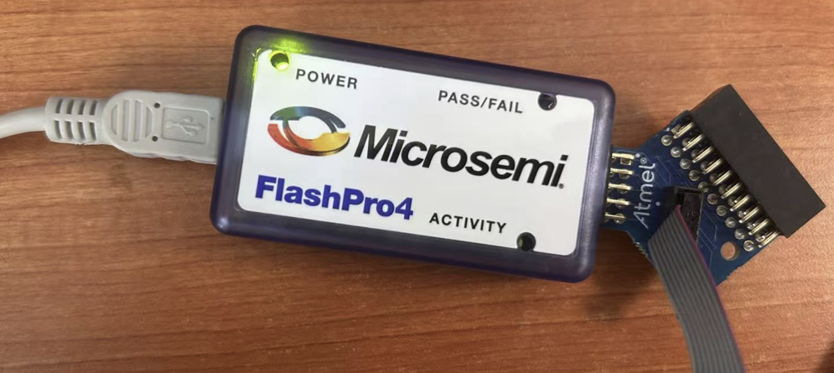
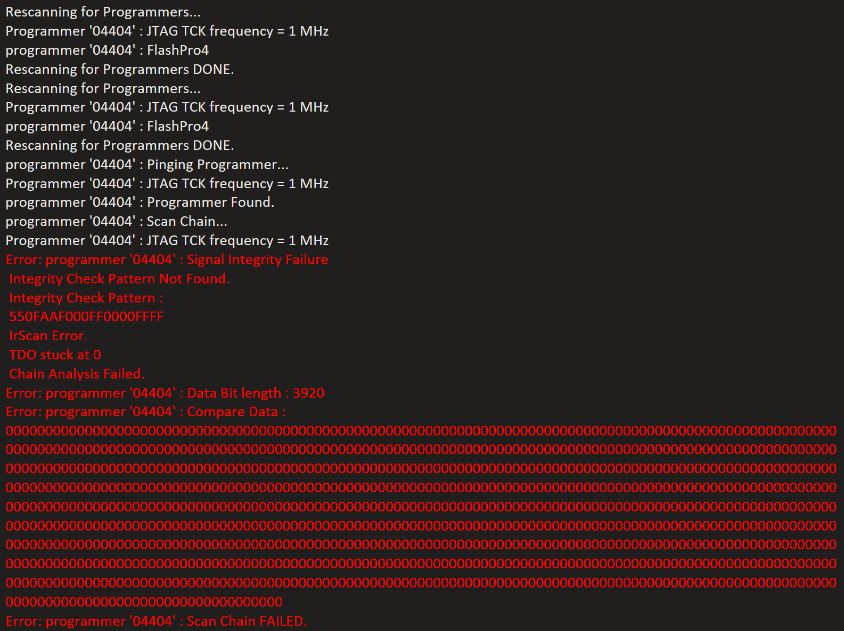
FPGA Programmer Configuration
Programmer Interface: JTAG
Programmer Type: FlashPro4
FlashPro Express Operation
Rescan programmers: Done
Ping: Found
Device INFO: FAILED
READ IDCODE: FAILED
…

Slide 2
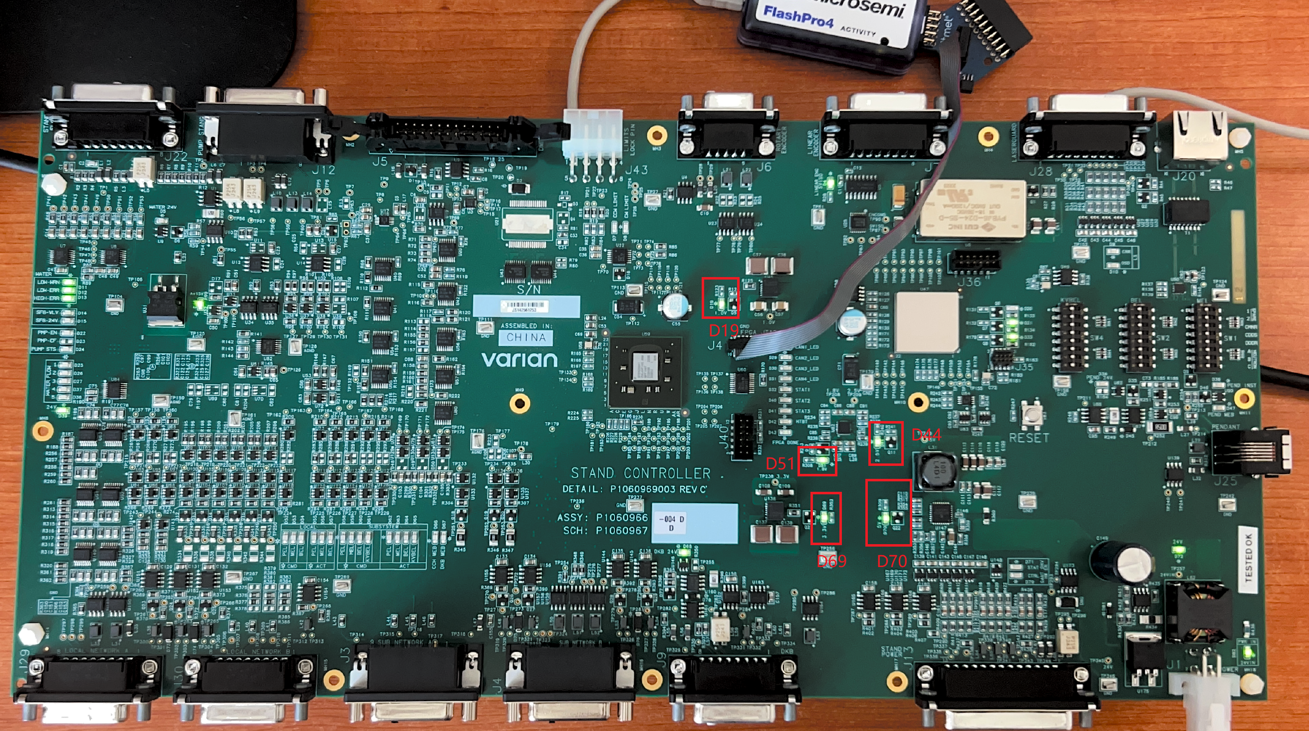
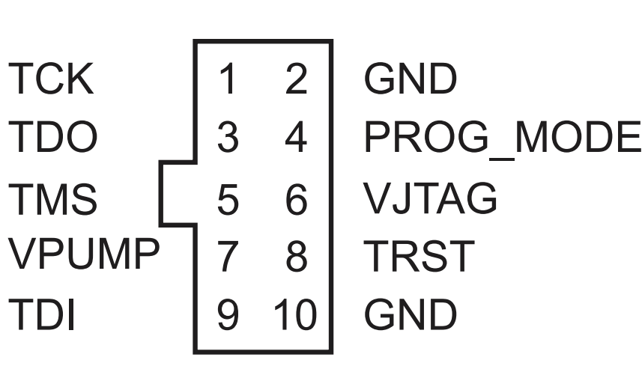
Check PCBA Power
J1-1: GND, J1-2: 24V
D70 (5V PG): ON
D69 (3.3V PG): ON
D44 (2.5V PG): ON
D51 (1.8V PG): ON
D19 (1.0V PG): ON
Check JTAG connector
J35
J41

Slide 3
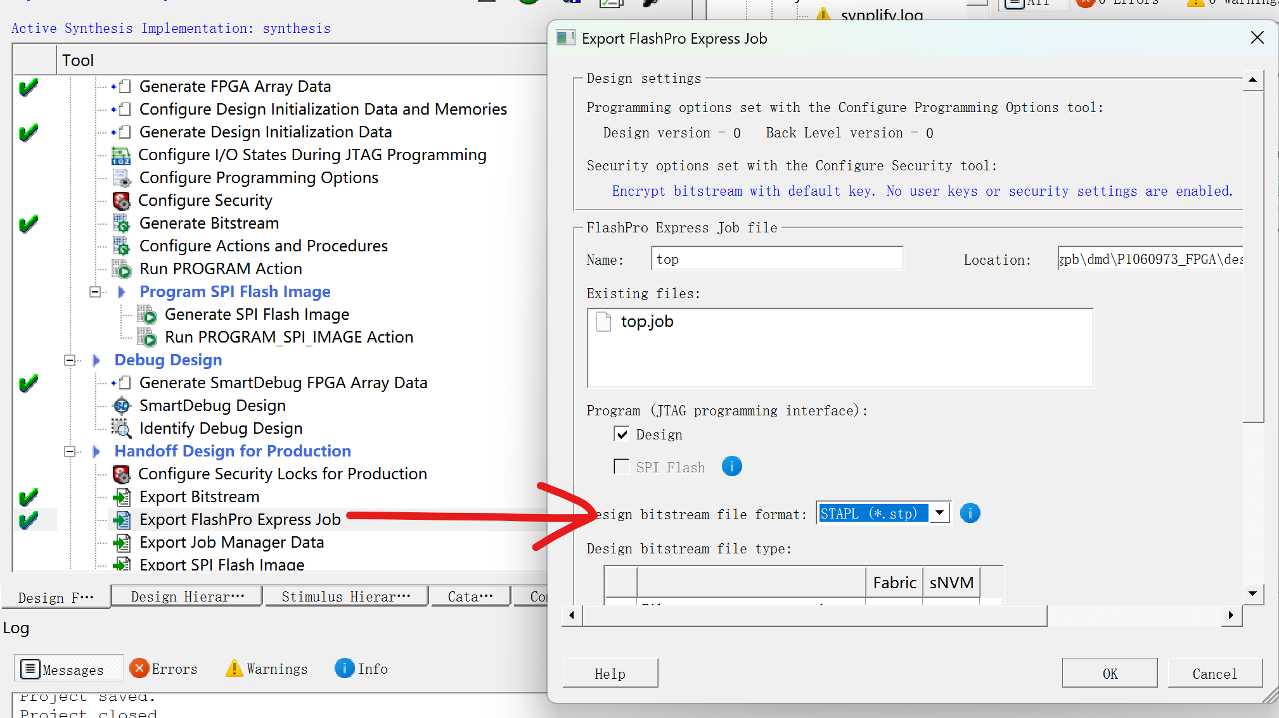
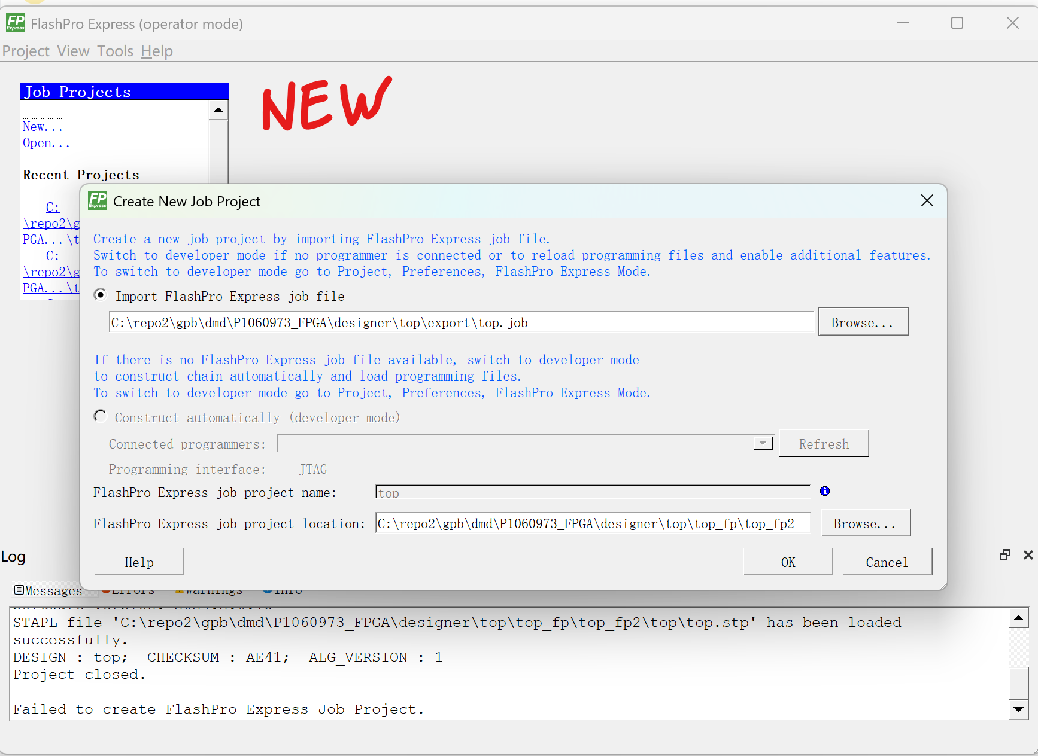
Procedures to export FlashPro Express Job for FlashPro4
Step-1. Export stp bitstream file in Libero
Step-2. create job project in FlashPro Express

